Slide 1
AI Solutions

Slide 2
Objectives
After completing this course, you will be able to:
Understand the development and application of the AI technology
Understand the Tencent Cloud AI service system
Understand Tencent Cloud AI solutions
Notes:
Training Target: Cloud architects. To participate in this training, you need to learn the Tencent Cloud Architecture TCA course first.

Slide 3
Section 1. Development and Application of AI
CONTENTS
Section 2. Tencent Cloud AI Service System
Section 3. Tencent Cloud AI Solutions
Notes:
Source: China Academy of Information and Communication Research and China Artificial Intelligence Industry Development Alliance

Slide 4
Section 1. Development and Application of AI
1.1 Basic concepts of AI
CONTENTS
1.2 Evolution of AI
1.3 AI industry chain

Slide 5
1.1 Basic concepts of AI
Artificial intelligence (AI) is a general term for products and related services that enable machines to have artificial intelligence such as perception, analysis, reasoning, and decision making by technical means, for example, computer and life science.
AI
Machine learning
Deep learning
Notes:
Artificial intelligence can be further divided into specialized artificial intelligence (ANI) and general artificial intelligence (AGI) in terms of its application scope. Dedicated AI, i.e., AI applied in a specific field, such as AlphaGo, which can play Go and only Go; general AI is AI that has the ability to transfer knowledge and skills, can learn quickly, make full use of the acquired skills to solve new problems, and reach or even surpass human intelligence. In the theoretical field, there has been no real breakthrough in general AI algorithms, and in the foreseeable future, general AI is neither the mainstream of AI discussions nor the technical path to become a reality yet. Dedicated AI is the protagonist that will really make an impact in this AI wave.
The optimization of AI algorithms currently relies on the training of large amounts of data, and the maturation of the Internet, cloud computing, and big data technologies has facilitated the development of AI.
The relationship between artificial intelligence, machine learning, and deep learning
Machine learning is a branch of artificial intelligence. The classical definition of machine learning given by Professor T. Mitchell, one of the founders of machine learning and a member of the American Academy of Engineering, in his classic textbook "Machine Learning" is "the use of experience to improve the performance of computer systems themselves". In general, experience corresponds to historical data (e.g., Internet data, scientific experiment data, etc.), system corresponds to data models (e.g., decision trees, support vector machines, etc.), and performance is the ability of the model to process new data (e.g., classification and prediction performance, etc.).
Deep learning is a technique in machine learning research, by building, simulating the human brain for analysis learning neural network, it imitates the mechanism of human brain to interpret data, and has made great breakthroughs in classification and recognition of images and speech, common deep learning algorithms are deep neural network (DNN), convolutional neural network (CNN), recurrent neural network (RNN)

Slide 6
1.1.1 Basic process of machine learning
Basic process of machine learning
Question definition
Data preprocessing
Model validation
Release and running
Data collection
Model training and tuning
Model ensemble
Data
Algorithm
Model
Three elements
Notes:
The basic process of machine learning
Define the problem: translate the business scenario problem into a mathematical problem that machine learning can handle, such as classification, regression or clustering of data
Data collection: The data determines the upper limit of the machine learning result, and the algorithm just approaches this upper limit as much as possible. The quality and quantity of the data need to be considered, and whether the sampling is reasonable.
Data pre-processing: Through feature engineering, the data to be predicted, such as regression values or classification labels, and the features that embody the analyzed problem are identified. The original dataset is transformed into a feature dataset and further split into training and test data.
Model training, diagnosis, and tuning: With the training data, selected algorithms train the model; diagnose whether the model is over-fitted or under-fitted by plotting learning curves, cross-validation, etc. Based on the diagnosis results, the model is tuned with superparameters (superparameters are configurations external to the model and the values of the parameters must be set manually) to optimize the model. Diagnosis and tuning is an iterative process.
Model validation: verify the validity of the model through test data, observe the error samples, and analyze the causes of the errors
Model fusion: Integrate multiple trained models through algorithms to improve model efficiency
On-line operation: do the engineering implementation and put the model into practical application.

Slide 7
1.1.2 Common algorithms of machine learning
Supervised learning
Unsupervised learning
Reinforcement learning
Regression
Classification
Clustering
Association
Dimensionality reduction
Random forest
Decision tree
Gradient boosting decision tree
Isotonic regression
Linear regression
Logistic regression
Naive Bayes
Linear support vector machine
Decision tree
Random forest
GBDT
k-nearest neighbors
K-means clustering
Gaussian mixture
Bisecting K-means clustering
Spectral clustering
FP-Growth
Apriori
PCA
ICA
Q-learning
DQN
Notes:
Supervised learning: Under supervised learning, the input training data has an explicit identification or outcome, such as an identification of the image content. The approach is generally designed to do make predictions about the results. There are two types of supervised learning problems: classification and regression
Classification: Predicts the outcome of a given sample where the output variable is in the form of a category. For example, classification of height, size
Logistic Regression: LogisticRegression (LR) algorithm is a common classification algorithm, which is widely used in the engineering field because of its simple model and strong interpretability. The algorithm supports binary and multiclass classification.
Naive Bayes: NaiveBayes is a common multi-class classification algorithm that assumes that individual features are independent of each other and calculates the probability that a sample belongs to a certain class by Bayesian formula. There are two types of plain Bayesian algorithms: multinomial naive Bayes and Bernoulli naive Bayes. This algorithm is commonly used for text classification, where each feature indicates the number of occurrences of a word in a document (multinomial naive Bayes) or whether it occurs (Bernoulli naive Bayes, a feature denoted by 0, 1).
Linear Support Vector Machine: LinearSVC is a linear SVM classifier, supporting only L2 regularity and binary classification
Decision Tree: DecisionTreeClassifier (decision tree algorithm) is a common classification/regression algorithm used in machine learning. Decision tree algorithm has good interpretation, can handle category features, supports multiple classifications, does not need to do feature scaling, and can represent nonlinear models. The decision tree classification algorithm on the platform supports multi-classification tasks with continuous and discontinuous features, and can support up to a million samples.
Random Forest: RandomForestClassifier is a random forest classifier that supports binary and multiclassification, discrete and continuous features.
GradientBoostedTrees: GradientBoostedTrees is a common classification and regression algorithm in machine learning. GradientBoostedTrees is a gradient boosting method that uses the CART algorithm in decision trees as a basis function, an additive model and a forward stepwise algorithm.
K nearest neighbors: KNN is used for classification by measuring the distance between different feature values. It is based on the idea that a sample belongs to a class if most of the k most similar (i.e., most neighboring) samples in the feature space belong to that class, where K is usually an integer no greater than 20.
Regression: Predicts the real-valued outcome of the output variable for a given sample. For example the specific value of height
Order-preserving regression: IsotonicRegressor (order-preserving regression) is a non-parametric regression model (nonparametric regression), the algorithm has only one constraint, that is, the function space for the space of monotonically increasing functions
Linear regression: Linear regression is a statistical analysis method that uses regression analysis in mathematical statistics to determine the quantitative relationship between two or more variables that depend on each other, and is widely used. Its expression form is y = w'x + e, e is the error obeys the normal distribution with a mean of 0.
UnSupervised learning: In unsupervised learning, the data are not identified. The approach is generally designed to infer some intrinsic structure of the data. Common application scenarios include the learning of association rules and clustering. Unsupervised learning problems are generally of three types: association and clustering and dimensionality reduction
Association: Discover the association of related data in a data set
FPGrowth: FPGrowth is an implementation of association rules. This algorithm constructs large-scale frequent sets into FPTree, which improves the efficiency of extracting frequent sets.
Apriori: Apriori algorithm is commonly used for mining out data association rules, it is used to find out the frequent data sets in data values, finding out the pattern of these sets helps us to make some decisions.
Clustering: Grouping samples and aggregating similar samples
KMeans: KMeans is a common clustering algorithm that clusters unlabeled data into K classes
Gaussian Mixture: GaussianMixture is a Gaussian mixture model that can be used for clustering
Dichotomous K-means: The dichotomous K-means algorithm belongs to hierarchical clustering, where first all points act as a cluster, and then the cluster is divided into two. After that, the cluster that minimizes the clustering cost function (i.e., the sum of squared errors) is selected and divided into two clusters. This continues until the number of clusters is equal to the number k given by the user
Dimensionality reduction: reduces the number of variables in the dataset while ensuring that important information is still conveyed
PCA: Principal Component Analysis (PCA) is used to make data easy to explore and visualize by reducing the number of variables.
ICA: Independent Component Analysis (ICA) is a statistical technique used to discover hidden factors under random variables.
Reinforcement learning: Reinforcement learning obtains learning information and updates model parameters by receiving rewards (feedback) for actions from the environment. Common application scenarios include dynamic systems as well as robot control
Q-learning: the process of reinforcement learning, in which there are states, actions, and rewards. If a behavioral strategy of an intelligent agent leads to a positive reward from the environment (reinforcement signal), then the tendency of the agent to produce this behavioral strategy in the future will be enhanced. The goal of the Agent is to discover the optimal strategy in each discrete state in order to maximize the desired discounted reward and to maximize the reward.
DQN: A Q-learning algorithm combining neural network algorithms in deep learning

Slide 8
1.2 Evolution of AI
1956
1957
1979
1980
1992
2006
2013
Dartmouth Conference marks the birth of AI
The neural network Perceptron is invented by Rosenblatt
Limited by computing power, the industry experiences its first stagnation period
The Xcon expert system is released and begins to achieve economic benefits
The high-dimensional kernel space form of support vector machine (SVM) is proposed by Vapnik
Hinton proposes a "deep learning" neural network
Deep learning algorithms make a major breakthrough in speech and visual recognition
Stage 1 (1956–1980s)
Stage 2 (1980s–1990s)
Stage 3 (1990s–2010s)
Stage 4 (2006–present)
1990–1991
1997
2011
2012
2016
2017
The Xcon expert system saves millions of dollars per year for enterprises
IBM's Deep Blue defeats the world chess champion
Apple's Siri comes out with continuous technical innovations
Google's self-driving car is put into use
AlphaGo defeats the Go champion
AlphaGo Master wins three games in a row against Ke Jie
Notes:
The concept of artificial intelligence was introduced and affirmed at an academic conference at Dartmouth University in the summer of 1956, marking the birth of the science of artificial intelligence. Unlike traditional computer technology where machines perform computational or control tasks according to a set program, artificial intelligence can be understood as the use of machines to constantly perceive and simulate human thought processes, so that machines can reach or even surpass human intelligence. It is commonly believed that AI applications are self-learning, self-organizing, self-adaptive, and self-acting, with effects that approximate biological intelligence.
In the course of more than 60 years of development history since the birth of artificial intelligence science, experts and scholars from various industries have done a lot of exploration and practice. Artificial intelligence has experienced three development climaxes: 1956-1970s, 1980-1990s and 2000s to the present.
Machine learning was introduced by Arthur Samuel in 1959, driving artificial intelligence to its first climax. This was followed by the emergence of expert systems in the late 1970s, marking the move from theoretical research to practical applications of AI.
From the 1980s to the 1990s, AI entered its second climax with the establishment of projects to support AI research in the United States and Japan, during which a series of major breakthroughs were made in AI-related mathematical models, such as the famous multilayer neural networks and BP backpropagation algorithms, which further improved the accuracy of algorithmic models and expert systems. During this period, researchers designed the LISP language and LISP computers, which eventually failed due to high cost and difficulty in maintenance.
In 1997, IBM Deep Blue defeated Garry Kasparov, the world chess champion, which was a milestone event. AI is currently in its third phase of development, thanks to the combined progress of algorithms, data, and computing power. In 2006, Professor Hinton of Canada introduced the concept of deep learning, which greatly developed artificial neural network algorithms and improved the self-learning ability of machines. With the popularity of the Internet and mobile Internet, the amount of global network data has increased dramatically, and the massive amount of data provides a good soil for the great development of artificial intelligence. The rapid development of information technology such as big data and cloud computing, and the application of various AI-specific computing chips such as GPU, NPU, FPGA, etc. have greatly improved the computational ability of machines to process massive videos and images. With the continuous improvement of algorithm, computing power and data capability, AI technology is developing rapidly. (Source: China Academy of Information and Communication Research and China Artificial Intelligence Industry Development Alliance)

Slide 9
1.3 AI industry chain
Disease prediction Medical imaging
Drug mining
Remote diagnosis
Autonomous vehicle
Traffic control Vehicle identification Vehicle detection
Smart lighting
Smart door lock
Home appliance control
Robot
Product inspection Smart OPS
Supply chain
Robot
Loan evaluation Robo-Advisor Smart customer service Financial regulation
Smart checkout Unmanned store Smart distribution Smart logistics
Traffic control Network control Network optimization Exception monitoring
Homework correction
Smart Q&A
Virtual class
Remote tutoring
Industry schemes
Smart healthcare
Smart transportation
Smart home
Smart manufacturing
Smart finance
Smart retail
Smart communication
Smart education
Application
layer
Face recognition, fingerprint recognition, voice print recognition, and iris recognition
Self-driving, unmanned surface vehicle,
rail transit, and drone
Industrial, dedicated,
service, and household applications
AI camera, smart speaker,
and smart wearables
Complex
Feature recognition
Smart transportation
Smart robot
Smart device
Technology
layer
Semantic understanding and machine translation
Knowledge graph
Speech recognition and text to speech
Image recognition, image processing, and OCR
Basic
Natural language processing (NLP)
Speech recognition
Computer vision
Machine learning platform, speech development platform, open image platform, and brain-inspired intelligence platform
Software and hardware
Chip (CPU, GPU, FPGA, and ASIC)
Brain-Inspired chip
Notes:
Based on the division of the foundation layer, technology layer and application layer, from the development of the AI industry chain to further understand the industrial applications of AI, AI+ applications have penetrated into many industry sectors.
Software and hardware support layer (i.e. foundation layer) This layer includes hardware and software platforms. The hardware mainly includes general-purpose chips such as CPU and GPU, AI chips such as deep learning and brain-like chips, and sensory storage hardware such as sensors and memory, and the leading manufacturers are mainly cloud computing service providers, traditional chip manufacturers and emerging AI chip manufacturers. Software platform can be subdivided into open platform, application software, etc. The open platform layer mainly refers to the developer-oriented machine learning development and basic functional framework, such as TensorFlow open source development framework, Tencent, Ali and other companies' technology open platform; application software mainly includes computer vision, natural language processing, speech recognition and other software tools and related application software developed by applying these tools.
The technology layer is the basic product, and the application layer is the composite product. The basic products include basic language processing products, computer vision products, speech processing products, which are the underlying technology products of AI and are the basis of AI terminal products and industry solutions. Composite products can be seen as artificial intelligence terminal products, is the carrier of artificial intelligence technology currently mainly includes wearable products, robots, unmanned vehicles, smart speakers, smart cameras, feature recognition devices and other terminals and supporting software artificial intelligence products in a variety of forms, has covered the auditory, visual, haptic, cognitive and other forms. Whether basic products or composite products, can support the processing of text, voice, image, perception and other forms of input or output, product forms are diverse, such as voice recognition, machine translation, face recognition, somatosensory interaction
Industry solutions refer to the penetration of AI technology into various fields to form "AI+" industry application terminals, systems and supporting software, and then cut into various scenarios to provide users with personalized, accurate and intelligent services, deeply empowering medical, transportation, finance, retail, education, home, agriculture, manufacturing, network security, security and other fields. Human resources, security and other fields
Source: China Academy of Information and Communication Research and China Artificial Intelligence Industry Development Alliance

Slide 10
1.3.1 AI technology application
Technology | Concepts | Scenarios | Challenges
Computer vision | Machine vision where computers replace human eyes to recognize, track, and measure targets | Smart home, audiovisual interaction, AR, VR, image search-based ecommerce, tag classification and search, beauty filters, smart security and surveillance, live streaming regulation, video platform marketing, and 3D analysis | Industry chain: the services are mainly at the midstream and downstream technology provision layer and scenario-based application layer. No Chinese enterprises participate in data training, computing power, and algorithm framework. Business: the businesses are homogenized, which mainly concentrate on face and image recognition.
NLP | Understanding the literal and context-specific meanings of words | Search engine: knowledge graph, deep Q&A, and recommendation and guide Machine translation: corpus processing, model processing, and translation methodology | Technology: the data volume directly affects the accuracy of semantic understanding. Application: development of new scenarios and technical talent pool both encounter a shortage.
Language technology | Use of signal processing and recognition technologies to make machines able to automatically recognize and understand spoken languages and convert them into text and commands | Smart TV, smart car, call center, voice assistant, smart mobile device, and smart home appliance | Technology: noise reduction, integration with visual technology, and dialect accent recognition are the three major technical challenges faced by speech recognition. In addition, the purpose of speech recognition is to convert speech signal to text, but the recognition accuracy is lower than that of fingerprint and iris recognition.
Notes:
Computer vision, natural language processing and speech technology are the three main directions of AI technologies in the technology layer, and their respective meanings and roles need to be understood. A wealth of solutions can be built from these three technologies, but there are also different challenges in terms of solution implementation.
Source: Deloitte AI Industry White Paper

Slide 11
1.3.2 How AI solves industry-specific challenges
Industry | Challenges | AI Solutions
Government | •The urban population keeps growing, and the related government services have huge workloads and are cumbersome • Crimes and terrorist attacks cannot be predicted | • Use technologies such as computer vision and machine learning to increase the proportion of self-service • Analyze suspects' life patterns and possible whereabouts with big data and use the computer vision technology to find and arrest them
Finance | • Financial institutions face pressure on operating costs • Financial institutions fail to provide customized products and services to long-tail customers • The credit dimensions lack variety, and financial risks such as bad debt and transaction fraud exist | • Use speech recognition, semantic understanding, and other technologies to build a smart customer service so as to solve users' service problems and reduce customer service costs • Use big data and AI to develop smart investment advisory services and provide personalized custom service to more customers • Combine AI and big data to build a smart risk management system that assesses data comprehensively in multiple dimensions and thus improves risk management capabilities
Healthcare | • Available healthcare resources cannot keep up with the demand due to uneven resource allocation • Seeking medical help is expensive and time-consuming • The doctor-patient relationship is strained, and misdiagnoses exist • The healthcare and medical treatment capabilities in communities are poor | • Use smart imaging to quickly screen early cancer symptoms and help patients detect lesions earlier • Access health management services through various devices such as mobile devices to change people's health habits from the source
Notes:
AI technology can effectively give solutions to the needs and pain points of different industries.
Source: Deloitte AI development white paper

Slide 12
1.3.2 How AI solves industry-specific challenges (continued)
Industry | Challenges | AI Solutions
Transportation | • Traffic accidents are frequent • Human attention span is limited • Freight costs are high | • Use the self-driving technology to liberate human hands and perception through sensing, computer vision, etc. and empower shared transport and unmanned logistics in order to greatly improve the efficiency of mobility and logistics
Retail | • Traditional market research methods can hardly unveil consumers' real needs • It is difficult to accurately reach the advertising targets and measure the effect of advertising • Consumers' requirements for good in-store experience, convenient payment, and timely delivery keep growing | • Use the machine learning technology to generate user profiles and place ads based on user preferences • Use the machine vision technology to capture customers' behaviors and analyze their real needs • Improve the consumer experience with technologies such as computer vision, speech/semantic recognition, and robot
Manufacturing | • Product development and design is time-consuming and costly • Manual processes have a high error rate and are difficult to be traced • The manpower costs of implementing mass and rapid customization are very high • There is a lack of low-cost workforce | • Use the computer vision technology to efficiently and accurately detect defective products • Use robots to replace human workers in dangerous places
Notes:
Source: Deloitte AI Development White Paper

Slide 13
Section 2. Tencent Cloud AI Service System
2.1 Tencent Cloud AI service system
2.2 Computer vision
CONTENTS
2.3 NLP
2.4 Speech technology
2.5 AI platforms
Notes:
Through the previous study, you have basically understood the development of AI, mainstream technology directions and industrial applications. In addition to these three technical directions, Tencent Cloud will also provide AI platform services to the public. Based on Tencent's AI platform, enterprises can build their own AI applications more conveniently and quickly. Through the study of this chapter, students can gain an overall understanding of Tencent Cloud's AI product system and the value it brings to enterprises.

Slide 14
2.1 Tencent Cloud AI service system
What are the barriers to entry for enterprises to develop AI capabilities?
Data
Algorithm
Computing power
Is the data sufficient?
Where can data be obtained?
Is a dedicated technical team available?
How high are the labor costs?
Is the supporting hardware sufficient?
Investment in IT infrastructure
How does Tencent Cloud help enterprises develop their own AI capabilities?

Slide 15
2.1 Tencent Cloud AI service system (continued)
Mature AI services:
Tencent Bot Platform (TBP) and Xiaowei
Mature AI applications enables enterprises to train their own AI customer service or audio robots by providing data and performing simple operations
Integrate enterprises' own applications through API calls
Speech technology: Automatic Speech Recognition (ASR), Text to Speech (TTS), and Voiceprint Recognition (VPR)
Computer vision: Optical Character Recognition (OCR), image recognition, and Face Recognition
Natural Language Processing (NLP) and Tencent Knowledge Graph (TKG)
These are general features that can be used after being integrated into applications through direct API calls and allow direct use of AI technology with no need to study algorithms and models
AI development processes are integrated into the platforms to provide diversified features such as built-in algorithm and automated parameter tuning, reducing the difficulty of enterprises' AI development
Build enterprises' own AI platforms:
TI-ONE and TI Matrix
Notes:
Tencent Cloud AI product system includes computer vision, speech technology and natural language processing mentioned in the first chapter, and also provides AI platform to the outside world to reduce the difficulty of using AI technology for enterprises. Among them, computer vision technology is divided into image recognition, face recognition and human body recognition. Specific product introduction will be expanded in the subsequent content.

Slide 16
2.2 Computer vision
Basic tasks
Image classification
Target detection
Target tracking
Image segmentation
Computer vision
Application
scenarios
Face recognition
Video structuration
Posture recognition
Notes:
Overview of computer vision: In general, computer vision is divided into four basic tasks: image classification, target detection, target tracking and image segmentation. Image classification refers to assigning category labels to the input images. Target detection refers to marking the position of an object with a box and giving the category of the object. Target tracking refers to the continuous identification of an object in the video. Image segmentation refers to subdividing an image into multiple image sub-regions. Actual implementations of computer vision products in use often require more than one of the four basic tasks. Currently, deep learning convolutional neural networks are more often used for model training.
Driven by policy guidance, technological innovation, capital pursuit, and consumer demand, computer vision applications based on deep learning have continued to mature, and three hot application directions have emerged.
Firstly, face recognition has landed first and opened a new era of "face painting". At present, face recognition has been applied to education, transportation, medical, security and other industry fields and specific scenarios such as building access control, traffic inspection, public area monitoring, service identity authentication and personal terminal device unlocking. From the Spring Festival in 2017, the railway station opened the "brush face" into the station, through the camera to collect the passenger's face information, and ID card face information for verification; September 2017 Apple released the iPhone X for the first time to introduce 3D face recognition into the public eye, quickly triggered the "mobile terminal + face unlock". Mobile terminal + face unlock" layout trend.
Secondly, video structuring has emerged and has broad application prospects. Video structuring is to label the target of unstructured data such as video with a corresponding label and turn it into structured data that can be searched by certain conditions. The goal of video structuring technology is to achieve automatic machine-based processing and analysis of video information. From the perspective of application prospects, the huge market potential faced by video surveillance technology provides a broad application prospect for video structuring description.
Thirdly, pose recognition allows the machine to "see and understand" and brings a new human-computer interaction experience. In visual human-computer interaction, pose recognition is actually an extension of human body language communication. Its main method is to detect, recognize and track the human body images obtained from imaging devices, and to understand and describe human behavior. From the perspective of user experience, human-computer interaction incorporating pose recognition can significantly improve the naturalness of human-computer communication, weaken people's reliance on mouse and keyboard, and reduce the complexity of control. From the perspective of market demand, posture recognition has a broad application prospect in computer games, robot control and home appliance control, etc. The market space is very promising.
Source: China Academy of Information and Communications Technology and China Artificial Intelligence Industry Development Alliance

Slide 17
2.2.1 Challenges to computer vision technology
Tasks
Challenges
Application technologies
Image classification
Size and shape changes of objects
Deep learning - convolutional neural network
Number of objects in the image
Target detection
Are the objects to be segmented covered?
Target tracking
Light intensity
Training with high amounts of data
Image segmentation
Positions and angles of objects in real-world environments
Notes:
In recent years, with the introduction of deep learning algorithms, the accuracy of object detection and recognition has been greatly improved, but there are still many practical problems that need to be solved in the actual application.
The position and angle of the object in the actual environment (different positions and angles of the object will result in very different extracted features, which will have a great impact on the accuracy of object segmentation)
The intensity of illumination (different illumination intensity will lead to confusion between the object and the background, which will affect the segmentation results)
Whether the object to be segmented is occluded or not (objects that are occluded are missing part of the image information, making segmentation more difficult)
The number of objects in the image (the uncertainty of the number of objects makes it necessary to first detect the number of objects when performing object recognition, which increases the complexity of the algorithm and the difficulty of detection and recognition)
Scale change and shape change of objects
All of the appealing problems bring great challenges to object detection and recognition, and are directions and problems worthy of in-depth research in the future. The current advances in neural networks and deep learning have greatly advanced the development of computer vision technology . --- "Chinese Pattern Recognition White Paper", Chinese Society for Artificial Intelligence

Slide 18
2.2.2 Tencent Cloud computer vision services
Service | Feature | Scenarios
 | Tencent Intelligent Image Analysis (TIIA): it can identify objects and scenarios in daily life and return the identified objects and corresponding confidence scores | Album classification, content recognition, ad recommendation, and ecommerce search (images browsed by users are analyzed for targeted information push)
 | Smart porn detection: it can detect pornographic, politically sensitive, and terrorist information in user images and return the scores of non-compliant images among input images | CSS, VOD, and UGC porn detection and pre-moderation for porn detection
 | OCR: it provides a wide variety of OCR services to meet the text recognition needs in different scenarios, with new features continuously released | User identity verification (finance and ride-hailing), non-compliant text recognition (ecommerce ads and subtitles), publication recognition, industry bill recognition (courier and finance), handwritten text recognition (tests, assignments, and insurance policies)
 | Gesture Recognition (GR): static gesture recognition and hand keypoint recognition (fingertips and gestures) | Human-Computer interaction scenarios such as smart home, VR, AR, and smart vehicle
Notes:
Tencent Cloud provides three types of services in computer vision technology to the public, including image recognition, face recognition, and human body recognition.
Image recognition
Intelligent Porn Identification is based on Tencent Youtu's deep learning image recognition technology, which allows machines to replace humans in image auditing by learning and analyzing the skin color, posture and scenes of image images. It supports providing image files or download addresses, automatically acquiring images for intelligent identification, and returning the pornographic score of images, which can efficiently identify pornographic images and sexy images with an accuracy rate of 99.95%. For high-confidence images can be directly combated, for the next high-confidence images can be delivered to manual audit confirmation according to priority, effectively helping enterprises to avoid the risk of business pornography, freeing up audit manpower and saving business expenses for you.
Tencent Cloud Image Analytics provides you with comprehensive image understanding and recognition services. It can recognize thousands of image tags, including commodities, daily necessities, animals, plants, etc., and supports custom tags according to demand. Based on image analysis, it can also help customers complete tasks such as deblurring, image quality enhancement, image quality evaluation, which is suitable for material aesthetic evaluation, platform content quality improvement, selfie entertainment and other scenarios; it supports image violation content identification, which can analyze whether there are pornographic, politically sensitive, violent and horrible elements in the images to maintain user Experience.
Optical Character Recognition (OCR), based on Tencent Youtu Lab's world-leading deep learning technology, intelligently identifies text content on images as editable text. It supports print recognition of ID cards, business cards and other cards and tickets, as well as handwritten recognition of waybills and other documents.

Slide 19
2.2.2 Tencent Cloud computer vision services (continued)
Service | Feature | Scenarios
 | Face Recognition: face detection and analysis, face comparison, face search, facial feature localization, and image-based liveness detection (for checking whether the person in the image is a real person) | Commerce: VIP customer management, foot traffic monitoring, and targeted advertising; security surveillance: access control and video surveillance; entertainment: album classification and makeup/beauty filters (facial feature localization)
 | Face Fusion: it can integrate the faces in images uploaded by users with specific faces and detect pornographic and politically sensitive information in the uploaded images | Publicity, (personal) image creation, and selfie camera
 | FaceID: identity card OCR, liveness detection, and face comparison | Integrated government service, police service through WeChat Mini Program, business registration, pensioner liveness verification, bank account opening, insurance verification, online mobile number application, SIM card purchase, broadband service application, internet access in internet café, hotel check-in, and transportation ticket check
 | Face Recognition Payment (FRP): it can verify identities based on facial features | Self-Service kiosk checkout, mobile checkout, and unmanned retail stores
Notes:
Face Recognition
Based on Tencent Youtu's world-leading facial analysis technology, Face Recognition provides a variety of functions including face detection and analysis, five senses positioning, face search, face comparison, face verification, and live detection, providing developers and enterprises with high-performance and highly available face recognition services. It can be applied to a variety of application scenarios such as smart retail, smart community, smart building, online identity authentication, etc., fully meeting the needs of customers in various industries for face attribute recognition and user identity confirmation.
Face Fusion refers to relying on face recognition algorithms and deep learning engines to quickly and accurately locate key points of faces and fuse the user's uploaded photos with a specific image at the facial level, so that the generated images have the appearance characteristics of both the user and the specific image. While fusing faces, it supports yellow and political identification of uploaded photos, which can improve the security of activities and reduce the risk of business violations.
Tencent Cloud Face Verification (the former financial-grade identity authentication upgrade) is a set of services to verify and audit the authenticity of user identity information, providing various authentication function modules, including document OCR recognition, live detection, face 1:1 comparison and other capabilities to address the large number of needs for user identity verification in the industry, widely used in public security, human resources, finance and insurance.
Tencent Cloud Face Recognition Payment (FRP) is based on Utu's self-researched reflective live technology and 3D structured light live detection technology, and uses human appearance features to complete identity authentication. It can intercept attacks such as photos, masks and videos. The use of face payment optimizes the payment process, effectively enhances the daily shopping and consumption experience of users, improves the transaction efficiency of merchants, and drives the development of the retail industry.
Human Body Recognition
Tencent Cloud Gesture Recognition (GR) is a new generation of human-computer interaction technology based on Tencent Audio and Video Lab, including static gesture recognition, key point recognition, fingertip recognition, gesture action recognition and many other functions, providing developers and enterprises with high-performance and highly available gesture recognition services. It can be used in many industries such as interactive entertainment, smart home, VR/AR, smart car, smart super and industrial quality control.

Slide 20
2.3 NLP
Basic
Complicated
Application
Automated tokenization
Lexical analysis
Syntactic analysis
Semantic analysis
Text classification
Automated summarization
Machine translation
NLP
Information extraction Information retrieval
Q&A system
Social computing
Sentiment analysis
Notes:
Natural language processing (NLP) is the field of computer science, artificial intelligence, and linguistics concerned with the interaction between computers and human (natural) language.
The most basic tasks of Natural Language Processing (NLP) include: lexical separation, lexical analysis, syntactic analysis, semantic analysis, etc.; among them, lexical separation refers to the separation of articles or sentences by meaning, in the form of word groups, whose English and Chinese are naturally separated by words due to their language format, while languages such as Chinese require the splitting of word groups. Lexical analysis refers to the splitting of word heads, roots, and endings in various languages, the classification of nouns, verbs, adjectives, adverbs, and prepositions in various languages, and the selection of multiple word meanings. Syntactic analysis refers to the analysis of sentence elements such as subject, predicate, object, definite article, gerund, and complement by means of a syntactic tree or other algorithms. Semantic analysis refers to expressing the correct meaning of a sentence by selecting the correct meaning of the words, guided by the correct syntax.
Based on these basic tasks, people can perform some relatively complex tasks: such as text classification, information retrieval, automatic summarization, etc. Based on these either basic or complex natural language processing tasks, people can perform some practical tasks that can change our life experience: such as machine translation, question and answer systems, emotional computing, social computing, etc. One of these tasks is text classification, which is the construction of an indexing database of text by keywords, so that when a query is made about a keyword, the content can be found quickly based on the indexing database. This direction is the basis of search engines. Information retrieval and filtering is the application area of instantaneous web inspection, which searches for keywords in a large flow of information and processes them accordingly when found. Information extraction is a more powerful tool for people to get information, extracting factual information directly from natural language text. Machine translation is the hottest application direction at present, and the new technology of Microsoft and Google is to combine translation and memory, and store a large number of previously correct translations through machine learning. Google uses deep learning technology to significantly improve the performance and quality of translation.

Slide 21
2.3.1 Challenges to NLP technology
Challenges
Used technologies
Development trends
Word boundary identification
Statistical machine learning
Deep text understanding and reasoning
Ambiguity
Chatbot
Fuzzy grammar
In-depth integration with professional fields
Deep learning
Corpus building
Text sentiment analysis
Notes:
Challenges of Natural Language Processing
Definition of word boundaries: In spoken language, words are usually connected to each other, and the usual approach to defining word boundaries is to take the best combination that makes the given context most fluent and grammatically correct. In writing, Chinese also does not have word boundaries.
Word disambiguation: Many words have more than one meaning, so we must choose the interpretation that makes the most sense.
Grammatical ambiguity: The grammar of natural languages is often ambiguous, and a sentence may be parsed into multiple parse trees, among which we have to rely on the semantic and contextual information to choose the most appropriate one.
Corpus building: Natural language processing requires large corpora. In many tasks, these corpora need to be constructed manually, which is a very laborious task. Therefore, data sharing is an essential factor that can facilitate research development.
Technology Development History
With the rapid growth of the Internet after the 1970s, the reality of rich corpora and the constant refinement of hardware, natural language processing techniques were largely based on statistical approaches. Jalinik and his IBM Watson Labs were key in driving this shift, using a statistical-based approach to increase speech recognition rates from 70% to 90% at that time. At this stage, natural language processing made substantial breakthroughs in mathematical models and statistics-based approaches, moving from the lab to practical applications.
From 2008 to now, motivated by the results in the fields of image recognition and speech recognition, people also gradually began to introduce deep learning to do natural language processing research, from the initial word vectors to word2vec in 2013, which pushed the combination of deep learning and natural language processing to a climax and achieved some success in the fields of machine translation, question and answer systems, reading comprehension, etc. RNN loops Neural networks are one of the most commonly used methods for natural language processing
Natural language processing technology trends
Text understanding and reasoning: shallow analysis towards deep understanding: text understanding and reasoning are an important part of natural language processing, and now
Machine software can now distinguish pronouns and other indicators based on the contextual background of the text, which is an important step in text understanding and reasoning from shallow analysis to deep understanding.
Conversational robots: practical and scenario-based: From the initial voice assistant in 2012 to 2014, to the chat robots Microsoft Xiaobing and Baidu Xiaodu that have gradually emerged since 2014, conversational robots are becoming more and more intelligent. The initial voice assistant can hear but not understand, after that the dialogue robot can understand but not strong practicality, now the dialogue robot is more combined with the scene, that is, to do a specific scene when the useful human-computer dialogue.
NLP is deeply integrated with professional fields: banks, electrical appliances, medicine, justice, education and other fields have a lot of demand for natural language processing. The combination of natural language processing and various industries is getting closer and closer, and the trend of specialized services is gradually increasing. Professor Ting Liu predicts that natural language processing will first produce breakthroughs in areas where information is well prepared and the service approach itself is knowledge and information, such as medical, financial, educational and judicial fields.
Text sentiment analysis: factual text to emotional text: previous research mainly focused on factual text in the field of news, but now emotional text analysis is more emphasized and can be well applied in business and government public opinion. For example, in 2017, Sina MicroPublic Opinion and HIT launched the "Sentiment Map", which allows Internet users to visit the official website of Sina Public Opinion to check the "Sentiment Map" of any keywords, which is the first official application of semantic sentiment analysis in the public opinion analysis industry. ---Natural Language Processing Research Report 2018, Tsinghua University - China Engineering Science and Technology Knowledge Center

Slide 22
2.3.2 Tencent Cloud NLP services
Service | Features | Scenarios
 | NLP: tokenization, named entity recognition, sentiment analysis, sensitive information detection, text error correction, keyword extraction, synonyms, automated summarization, text classification, etc. | Analysis of user comments in social media, sensitive information moderation for online text, structured information extraction, and smart text error correction
 | Tencent Machine Translation (TMT): text translation, automated language recognition, image translation, and speech translation | Document translation, articles and news reading, translation of websites in foreign languages, foreign language learning inquiry, oral tutoring, and overseas travel service
 | TKG: it supports quickly searching for, finding, and browsing data in trillions of associated graphs as well as deeply mining the knowledge hidden in association | Finance: customer relationship sorting and customer risk prediction; generic security: user relationship graph; IoT: IoT data ingestion, management, and analysis
Notes:
Natural Language Processing
Tencent Cloud Natural Language Process (NLP) deeply integrates the top NLP cutting-edge technologies within Tencent (including AI Lab, information security team and Zhiwen team), relying on the accumulation of massive Chinese corpus, and comprehensively covers intelligent text processing capabilities from basic to advanced. The basic version includes sentiment analysis, lexical analysis, text correction, text classification, etc., while the advanced version includes sensitive word recognition, text review, etc.
Tencent Machine Translation (TMT) combines the advantages of neural machine translation and statistical machine translation to automatically learn translation knowledge from a large-scale bilingual corpus to realize automatic translation from source language text to target language text, and can currently support mutual translation in more than ten languages.
Tencent Knowledge Graph Database (TKGD) is an integrated platform of graph database and graph computing engine. TKGD integrates and manages heterogeneous and heterogeneous data; provides correlation query, visual graph analysis, graph mining, machine learning and rule engine; supports fast retrieval, finding and browsing of trillions of correlation data; mines hidden relationships and models business experience. Tencent Knowledge Graph Database, as a knowledge graph solution for financial AI risk control and other pan-security fields, can enhance enterprise business and catalyze new business models.

Slide 23
2.4 Speech technology
Technical
directions
ASR
TTS
VPR
Smart Oral Evaluation (SOE)
Speech technology
Human-Computer interaction
User requirements
Organizational user
Individual user
Notes:
Overview of intelligent speech technology: According to the different roles played by machines, they are divided into speech synthesis technology, speech recognition technology, speech evaluation technology, etc. Speech synthesis technology is to make the machine speak by automatically converting text information into speech, which is equivalent to the machine's mouth; speech recognition technology is to make the machine understand human speech by automatically converting speech signals into text and related information, which is equivalent to the machine's ear; speech evaluation technology is to automatically score pronunciation, check errors and give corrective guidance by the machine. In addition, there are also voice recognition technologies that can identify people based on their voice characteristics, voice conversion technologies that can realize voice change and voice imitation, and voice noise cancellation and enhancement technologies.
Intelligent voice technology will become the new way of human-computer interaction in the future, and will become the main way of human-computer interaction in the future from several application forms. Smart speaker products enhance the convenience of home interaction. Smart speaker is the transition from passive music playback to active access to information, music and control the flow of the entrance. The current smart speaker with voice interaction technology as the core, as the entrance to smart home devices, not only to connect and control all kinds of smart home terminal products, but also to join the personalized services, such as booking tickets, checking the weather, playing audio and other capabilities.
Personal intelligent voice assistant has reshaped the human-computer interaction mode. Personal voice assistants, especially those embedded in cell phones, smart watches, personal computers and other terminals, will significantly improve the ease of use of these products. For example, Siri, Apple's virtual voice assistant, is deeply integrated with Homekit, Apple's smart home platform, so users can control their smart homes by voice, and Google Now provides users with content they care about, such as news, sports games, traffic, weather, etc. Microsoft's Cortana's main advantage is to improve the ease of use of personal computers. Intelligent voice services in the form of
Smart voice services in the form of APIs have become an important portal for industry users. Intelligent speech APIs mainly provide online services related to speech semantics, which can include speech recognition, speech synthesis, voice recognition, voice dictation and other types of services, and can be embedded into various products, services or APPs. In the business end, there is a strong demand for intelligent customer service, education (spoken language assessment), medical treatment (electronic medical records), finance (business processing), security, law, etc. In the personal user field, there is a strong demand for smart phones, autonomous driving and assisted driving, traditional home appliances, smart home, etc.
Source: China Academy of Information and Communication Research and China Artificial Intelligence Industry Development Alliance

Slide 24
2.4.1 Challenges to speech technology
Challenges
Oral expression: accent, slurred, swallowed, and changed sounds, non-standard language structure, etc.
Ambient noise
Used technologies
Deep neural network (DNN)
Recurrent neural network (RNN)
Convolutional neural network (CNN)
Deep learning
Notes:
Voice technology challenges.
Spoken expression problem: there are many spoken phenomena such as ambiguous pronunciation, swallowed sound variation, poor grammatical structure, repetition, insertion, correction, etc. The complex accents and multilingual mixing phenomena have brought great challenges to speech recognition. For the above reasons, the problem of natural spoken expression has become one of the research hotspots in the field of speech recognition in recent years.
Environmental noise problem: Although existing speech noise reduction models have made great progress in solving the problem of non-smooth noise, the noise environment in practical applications is much more complex and variable, which also leads to many limitations in the performance of speech recognition in complex noise environments still.
In terms of speech recognition methods, although the current deep neural network (DNN) based methods have significantly improved the current speech recognition performance and become the mainstream method for speech recognition. However, the training complexity of DNNs is still an urgent problem when larger scale neurons and layers are used. Recurrent Neural Network (RNN) has gradually replaced the traditional DNN as the mainstream speech recognition modeling scheme in recent years. At the same time, the existing methods are still unable to achieve satisfactory recognition results when facing small resource speech, as well as speech recognition in the case of partially missing speech due to noise and channel problems. In recent years, human-like auditory information processing research has gradually emerged in an attempt to design and implement human-like auditory perception models and corresponding algorithms by drawing on the channel-independent and auditory separation mechanisms of human auditory perception, simulating human noise-resistance mechanisms and speech recognition cognitive processes, and using them to solve a series of problems such as noise, accent, auditory deficit, and self-adaptation. --- "Chinese Pattern Recognition White Paper", Chinese Society for Artificial Intelligence

Slide 25
2.4.2 Tencent Cloud speech technology services
Service | Feature | Scenarios
 | Real-time speech recognition and audio recording file recognition | Voice input method, TTS, subtitles generation, meeting minutes, and call quality control
 | TTS: speaker customization service is provided to make pronunciation more native, professional, and appropriate in specific scenarios | Voice navigation, audiobooks, robot, voice assistant, and automated news broadcasting
 | VPR: speaker recognition, random digit password, and specified text password | Smart home, secure financial transaction, and smart building
Notes:
Voice Technology
Tencent Cloud's Automatic Speech Recognition (ASR) provides developers with the best experience in speech-to-text services. The speech recognition service has been verified by a large number of internal businesses such as WeChat, Tencent Video, and King of Glory, and has also been successfully implemented in a large number of external customer business scenarios both online and offline. Tencent Cloud speech recognition service is open to three types of services: real-time speech recognition, one-sentence recognition and recorded file recognition to meet the needs of different types of developers
Text To Speech (TTS) meets the needs of converting text into anthropomorphic speech to close the loop of human-computer interaction. It provides a variety of tone options, supports custom volume and speech speed, and provides personalized tone customization services for enterprise customers, making pronunciation more natural, professional, and in line with the needs of the scene. Speech synthesis is widely used in voice navigation, audiobooks, robots, voice assistants, automatic news broadcast and other scenarios to enhance the human-computer interaction experience and improve the efficiency of building speech-based applications.
Voice Print Recognition (VPR), as a kind of biometric recognition, is a service for identity recognition based on the characteristics of the speaker's sound waves. Identity recognition is accent-independent and language-independent, and can be used for speaker identification and speaker confirmation, and is widely used in financial security, smart home, smart building and other fields.

Slide 26
2.5 AI platforms
AI platforms
1
Overview of AI platforms
2
TI-ONE
3
TI Matrix
4
TBP

Slide 27
2.5.1 Overview of AI platforms
TI-ONE
TI Matrix
TBP
Notes:
Intelligent Titanium Machine Learning (TI Machine Learning, TI-ML) is a one-stop machine learning ecological service platform based on the powerful computing power of Tencent Cloud. It can combine various data sources, components, algorithms, models and evaluation modules, enabling algorithm engineers and data scientists to easily train, evaluate and predict models on top of it. Smart Titanium Machine Learning includes three sub-products: TI-ONE, a one-stop machine learning platform for the entire process, TI-EMS (TI-Elastic Model Service), an elastic model service management platform, and TI-Insight, an industrial AI platform. Meanwhile, the Smart Titanium series products support public cloud access, privatization deployment and exclusive cloud deployment.
Tencent's Cloud Intelligence Matrix Platform (TI Matrix Platform, also called Cloud Intelligence Matrix Platform in the following) is a full-stack AI service platform based on Tencent Cloud and Tencent Youtu's powerful technical capabilities, which is dedicated to helping accelerate the digital transformation of enterprises and promoting the ecological co-construction of AI industry. The platform supports rapid access to various data, algorithms and smart devices, and provides visual scheduling tools for service and resource management and dispatching, and further reduces AI application development costs through AI service component integration and standardized interface opening.
Tencent Intelligent Dialogue Platform (TBP) focuses on the vision of "Dialogue as a Service" and fully opens up the core technology of Tencent's dialogue system to provide a development platform and bot middleware capabilities for large enterprise customers, developers and ecological partners to realize convenient and low-cost construction of It provides a development platform and bot middleware capabilities for large enterprise customers, developers and eco-partners, enabling convenient and low-cost construction of human-robot dialogue experience and efficient and diverse empowerment of the industry.

Slide 28
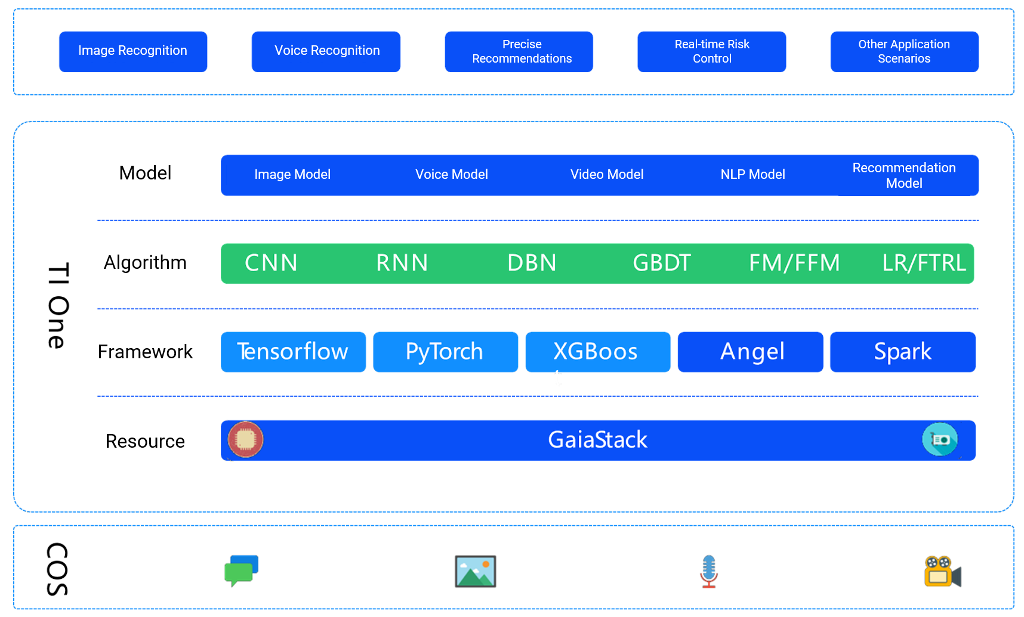
2.5.2 TI-ONE
Notes:
Value of the TI-one platform.
Technical Value
The AutoML fully automated machine learning component makes it easy for non-AI practitioners to apply machine learning to solve various problems and gain value.
Semi-automatic tuning technology will significantly improve the efficiency of tuning for AI practitioners, so that time is no longer wasted on manual and inefficient trial and error.
Highly available GPU distributed cluster servers in the cloud to meet the performance requirements of large-scale deep learning model training and support anytime purchase and use.
GPU-based distributed machine learning platform, compatible with TensorFlow, Pytorch, Pycaffe and other mainstream open source machine learning frameworks, users can flexibly define algorithm modules on the platform
Business Value
The Smart Titanium Machine Learning Platform optimizes deep learning model training algorithms on GPU distributed cluster servers, enabling significant improvements in training speed and thus reducing model training time. Compared to the native TensorFlow framework, Smart Titanium Machine Learning Platform can train 1 - 3 times faster on a 128 GPU card cluster.
With Smart Titanium Machine Learning Platform, users can save time building machine learning platforms and managing physical resources to focus on more business-valuable modeling efforts.
The one-click deployment of models allows users to seamlessly align their trained models with actual scenario business, while the grayscale upgrade and traffic allocation functions of the service version help users to flexibly perform upgrade and rollback operations in actual business, significantly reducing the risk of version switching.

Slide 29
2.5.2 TI-ONE (continued)
Machine learning lifecycle
Data
About 50% of time is spent on feature extraction and preprocessing
Prediction
Preprocessing
Servitization
Framework algorithm
About 10% of time is spent on algorithm writing and debugging
Model
About 10% of time is spent on model deployment and servitization
Parameter tuning
About 20% of time is spent on trying various hyperparameter combinations
Notes:
How can TI one improve the machine learning lifecycle?
Integrated data pre-processing platform, improve data pre-processing efficiency
Support mainstream machine learning framework, built-in common algorithms, drag and drop to complete the algorithm development
Support automatic parameter tuning
Support multi-level collaboration
Support one-click model deployment and service generation
Support online inference

Slide 30
2.5.3 TI Matrix
Connection layer
Data layer
Logic layer
Open layer
Connection to various devices
Compatibility with various device protocols
Data storage
Connection to multiple storage media
Visualized orchestration
Standard API/SDK
Access to various data sources
Compatibility with various data specifications
Data conversion
Support for multiple industry standards
Efficient task execution
Simple secondary development
Access to various models
Provision of multiple access protocols
Data annotation
Support for multiple annotation scenarios
Flexibility, simplicity, and compatibility
Notes:
Ti Matrix Platform: Build AI applications and solutions at low cost. (Private deployment only supported)
Provides enterprises with the ability to build intelligent applications from four aspects: connectivity layer, data layer, logic layer, and open layer
Connection layer: It mainly provides access and adaptation functions for data, devices and algorithm models required to build AI applications, providing atomic capabilities required for AI applications and accelerating the construction of AI applications.
Data layer: It mainly provides data storage functions, supports multiple storage media, and can store large amounts of structured and unstructured data; in addition, it also provides data processing functions such as data conversion and data annotation, so that the atomic capabilities accessed in the access layer can be better used by the AI application layer.
Logic layer: The main purpose is to arrange and schedule the data, devices and algorithms accessed from the access platform in a unified manner. Through flexible arrangement and combination, AI scene templates can be quickly assembled to meet the needs of different application scenarios, thus further reducing the cost of AI application construction.
Open layer: Finally, there is the open layer, where all the atomic capabilities of the platform and the functions of the platform can be open interfaces to the external application layer in the form of standard API/SDK to help build AI applications.

Slide 31
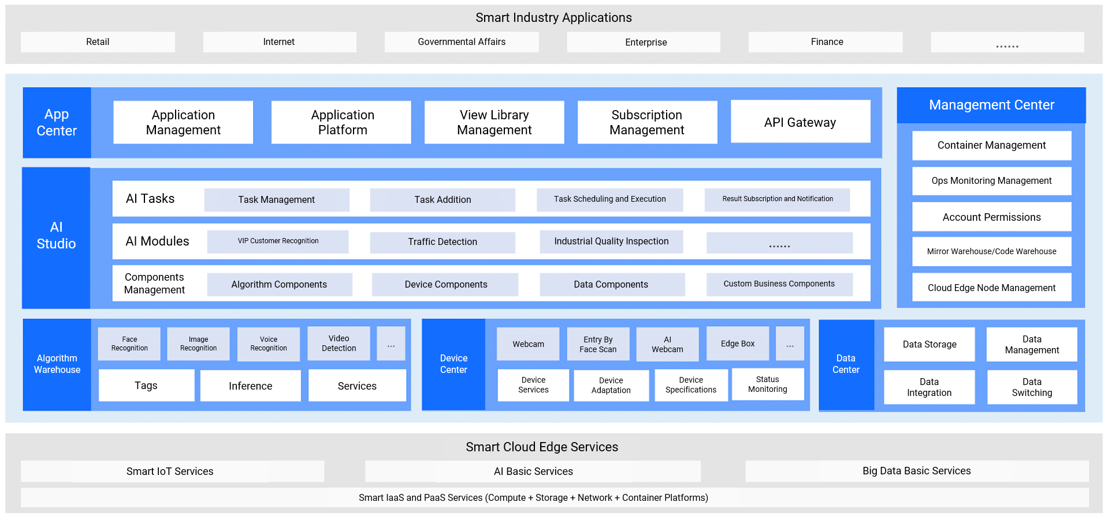
2.5.3 TI Matrix (continued)
Notes:
There are 6 modules in the Cloud Intelligence Hub platform, which are Application Center, AI Studio, Algorithm Warehouse, Data Center, Device Center, and Management Center.
The algorithm warehouse, device center, and data center access algorithm models, access devices, and access data, respectively, and the corresponding adaptation work. It corresponds to the access layer on the previous page.
The algorithm repository is for algorithm model providers, who can access various algorithms and models as AI atoms through this module according to the specifications of the platform. The device center is for device providers, who can access various intelligent and non-intelligent devices through this module according to the specifications of the platform, and access the platform as a device atom. The data center, on the other hand, carries data access as well as data layer capabilities and is responsible for accessing, storing, adapting, converting, etc. data.
The AI studio is as the bearer module of the logical layer capability, responsible for the unified scheduling of data, algorithms and devices that access the platform and orchestrate them according to application scenarios, and the orchestrated AI templates can be instantiated into individual AI tasks in execution. The results of each Ai task can be pushed to the application layer for statistics, analysis and display.
The application center is the capability-bearing module of the open layer, which is oriented to application developers. Developers can access the relevant API interfaces through the key of the application center and develop AI applications based on the interface capabilities provided by the platform.
In addition, the management center is the capability of the relevant management modules of the platform, thus forming a complete platform.

Slide 32
2.5.4 TBP
Technical component
Feature
Use case
ASR
Robot middleware
Information inquiry robot
Task service robot
TTS
Service configuration
Enterprise production robot
NLP
Website simulator
Smart customer service robot
Cloud Call Center (CCC)
Application access
Call center robot
Notes:
Tencent Intelligent Dialogue Platform (TBP) focuses on the vision of "Dialogue as a Service", fully opens up the core technology of Tencent's dialogue system, provides development platforms and bot middleware capabilities for large enterprise customers and partners, and realizes efficient, convenient, diversified and low-cost Human-robot dialogue experience
Function
Bot middleware: Tencent Intelligent Dialogue Platform provides users with powerful bot middleware capabilities. Developers can define Task-based Bot (task-based bot) semantic models and QnA Bot (question-and-answer bot) question-and-answer collections on the platform, or directly invoke the platform's built-in bot capabilities.
Service configuration: Tencent Intelligent Dialogue Platform provides users with diverse service configuration capabilities, and developers can flexibly configure back-end business logic.
Tencent Intelligent Dialogue Platform will provide cloud function capabilities in the future to lower the threshold for bot development.
Web simulator: Tencent Intelligent Dialogue Platform provides users with web simulator capabilities. Developers can conduct natural language understanding and business logic testing of robots through the web simulator.
Application access: Tencent Intelligent Dialogue Platform provides users with multi-channel application integration capabilities, enabling developers to significantly reduce the workload of multi-platform development and integrate their developed robots into multiple terminals such as mobile apps, websites and IoT devices, and to connect with the WeChat public number operation platform, supporting zero-code access to WeChat public numbers.
Application Scenarios
Information query robots: Build query and answer type robots for news query information, sports event score query, express logistics, etc.
Task service robots: Build task-based dialogue robots for flight booking, hotel booking, financial business processing, cab booking, and other industries.
Enterprise productivity bots: Build enterprise efficiency bots that connect with enterprise business systems to improve organizational efficiency.
Intelligent customer service robot: build customer service robot core dialogue logic and response management, empower traditional customer service vendors with robot capabilities, and achieve cost reduction and efficiency.
Call center robot: build call center robot core conversation logic and response management, connect with call platform, and improve marketing efficiency.

Slide 33
Section 3. Tencent Cloud AI Solutions
3.1 FaceID
3.2 Smart customer service
CONTENTS
3.3 YouTu GrandEye solution
3.4 AR cloud service solution
3.5 Smart venue solution
Notes:
Through the above understanding of AI application scenarios and Tencent Cloud AI product system, next we further understand the solutions based on Tencent Cloud AI products and their corresponding usage scenarios. These include face verification solution, intelligent customer service solution, Youtu Sky Eye solution, AR cloud service solution, and intelligent venue solution.

Slide 34
3.1 FaceID
FaceID
Industry | Scenario | Description
Finance | Bank/Securities | Businesses such as remote account opening and large amount transfer
 | Insurance | Remote identity and liveness verification for the insured
Internet | Live streaming | Host identity verification
 | Ride-Hailing platform | Driver and passenger identity verification
Education | Online Education | Online student identity verification
 | Exam | Student identity verification for preventing surrogate exam takers and cheaters
Public security | Municipal administration | Identity verification in certificate application
 | Security surveillance | Identity verification at entry/exit for detecting fugitives
Notes:
Financial Industry
For banks or securities companies, which require high authenticity of user identity, using online face verification service can greatly reduce the manpower investment of banks, and also realize remote account opening and large amount transfer to improve the convenience of users.
For commercial insurance companies or social security institutions, participants may not be able to apply in person due to age, illness and other reasons, and the identity and survival status of participants will be difficult to determine.
Internet
The rapid development of the live video industry, a variety of unhealthy content comes with it, the industry's norms call for the emergence. Through the online face verification service, the real identity of the anchor can be audited and recorded to avoid the risk of illegal content
With the popularity of mobile Internet, online taxi has become inseparable from everyone's life. Through online face verification service, the real identities of drivers and passengers can be accurately verified to restrain and reduce the occurrence of crimes
Education
With the rapid development of the Internet and the imbalance of teachers, online education came into being. Compared with traditional face-to-face classroom teaching, student identity verification has gradually become a problem, and the remote face verification solution perfectly solves this problem
Both traditional education and online education end-of-course exams face the problem of candidate identity verification. Through online face verification services, the cost of human verification is reduced and the occurrence of substitution is effectively reduced
Public Security
Services such as ID card replacement, residence permit application and immigration document application require accurate verification of the user's identity. The use of remote face verification service will greatly improve the efficiency of municipal processing and greatly reduce the cost for users
For densely populated places such as airports, large exhibitions or office buildings, the intelligent face verification service can effectively verify the identity of people entering and exiting, quickly screen whether there are fugitives from justice and key monitoring personnel, and reduce security risks.

Slide 35
3.1 FaceID (continued)
FaceID
Massive amounts of training data
Online identification
High accuracy
High security and reliability
Notes:
Use process: Users scan the front and back of the ID card, through the ID card OCR recognition to obtain and display the user's identity information, confirm the identity information, real-time recording of a video for live detection, determine whether the real person, if the real person, the information will be given to the public security authority library verification, and finally give the identity results
Solution: Support WeChat H5, native APP (iOS and Android platforms) and WeChat applet, real-time interaction to meet user needs.
Solution advantages
Massive training data: Based on Tencent's social data platform, it has massive data analysis and face and image training sets, close to actual business and covering various scenarios.
Online recognition: Based on the user's selfie photo or video, combined with Tencent Youtu's OCR, live detection and face recognition technologies, the real and valid identity of the user is verified.
High recognition accuracy: The face recognition function is based on deep learning intelligent recognition technology, based on Tencent's social platform, and has a large number of face and image training sets, with world-leading accuracy.
Safe and reliable: Live detection can resist attacks from photos, videos and static 3D models, and combined with Tencent's years of security accumulation, it provides reliable security.

Slide 36
3.1 FaceID (continued)
Traditional finance business process
Offline user biometrics verification
Low efficiency
WeBank remote FaceID
Face recognition technology
Liveness detection integrating lip language
Error rate lower than 1‰
Notes:
In traditional financial business processes, all services require offline verification of users' biometric features, which has become the biggest bottleneck in the efficiency of traditional financial business and also a key node restricting the Internetization of financial enterprises. Biometric remote identification has become the development trend of Internet finance.
Wezubank has had deep cooperation with Tencent in remote face verification since the beginning of its establishment. In its business process, users are required to conduct remote identification when binding a second bank card. By using Tencent Youtu's original live detection technology combined with lip-speaking and the world's leading face recognition technology, the bank has achieved an error rate of less than one in a thousand in remote identification of user identity.

Slide 37
3.2 Smart customer service
Smart customer service
1
Overview
2
Technical architecture
3
Customer service quality improvement

Slide 38
3.2.1 Overview
Solution-Related services
ASR
NLP
TKG
TBP
Success stories
Notes:
Products covered by the program
Intelligent voice service is jointly launched by Tencent Cloud and WeChat Intelligence team to meet voice recognition, speech synthesis, voice recognition and other voice processing needs. Powerful vertical customization services to build a professional and efficient voice brain
Tencent Intelligent Dialogue Platform focuses on the vision of "Dialogue as a Service" and opens up the core technology of Tencent Dialogue System to provide enterprise customers, developers and ecological partners with a development platform and robot middleware capabilities to realize a convenient and low-cost human-computer dialogue experience.
Tencent Natural Language Processing relies on Tencent's 100 billion Internet corpus and has hundreds of related technology patents and core technology papers, providing enterprise customers, developers and ecological partners with lexical, syntactic, chapter-level and vector-level text AI processing capabilities.
Tencent Knowledge Graph Database integrates graph database, graph computing, association query, visual graph analysis, graph mining, machine learning and rule engine to support fast retrieval, Q&A and recommendation of trillions of associated relational data and help enterprises quickly build graph business models.
Customer Cases
ZhenAi: Facing the rapid growth of ZhenAi's business, the intelligent customer service platform provides quality service, low cost and fast completion of 3000 offline red-heads' telephone service quality improvement and quality inspection, ensuring business health.
China Merchants Trust: AI intelligent robots solve 65% of customer service problems, providing customers with more efficient services, openness and expandability, providing more possibilities for the direction of customer service intelligence.
Microlife Bank: The total number of users served by the intelligent customer service platform reached the million level, enabling Microlife to serve users at low cost 7X24 hours, and still maintain user experience while users grow at high speed, striking a balance between efficiency and cost.

Slide 39
3.2.2 Smart customer service technical architecture
User
Text semantics
Preprocessing
Tokenization
FAQs database
Part-of-Speech tagging
WeChat Official
Account
Named entity recognition
Index
Semantic understanding
Website
Semantic knowledge base
Question match
Question-based search
FAQs library
QQ
Long/Short time format conversion system
Question match
Real-Time recognition
Candidate results
Question similarity calculation
Answer processing
Notes:
Technical architecture: With Tencent's intelligent dialogue platform as the core, it recognizes user's voice through speech recognition technology, does pre-processing and semantic understanding of user input text information and user language transformed by language recognition technology based on natural language processing technology, and uses knowledge mapping to realize rapid retrieval, Q&A and recommendation of relational data and build business models.
Solution Value
7X24 online intelligent customer service, no waiting in line
Intelligent question and answer interaction to enhance the intelligent customer service experience
More intelligent answer content and richer business scenarios
With machine learning capability, the more you use it, the smarter it is, and constantly improve the quality of the response
Assist manual customer service to quickly search for answers and improve customer service efficiency
Search for matching answers through AI semantic search engine to accurately answer users' questions
Filtering out intended users through message filtering and quickly transferring to human customer service to grasp business opportunities in seconds
Based on semantic judgment, the robot can quickly trigger human service at any time for questions that cannot be answered, improving the efficiency of the flow from robot to human and upgrading the customer experience.
Usage Scenarios
Auxiliary manual customer service is efficient and collaborative: a rich library of pleasantries, which fits the business scenario and simulates real-life dialogue in a friendly and natural way; robots can capture customer intentions through message filtering, accurately divert and trigger manual services, and filter out more valuable high-net-worth users through efficient question and answer processing; AI intelligent robots assist manual customer service in all scenarios, intelligently guide and quickly transfer to manual, and improve the flow efficiency from robots to manual. The AI intelligent robots assist manual customer service in all scenarios, intelligently guide and quickly transfer to manual, improve the efficiency of the flow from robot to manual, and upgrade customer experience
Intelligent learning to enhance conversion: powerful AI technology intelligently captures keywords, quickly understands user semantics with the knowledge base, and accurately determines user intent; evolves from supervised learning to self-learning mode, and uses Tencent's AI deep learning for many years to constitute the core algorithm mechanism, making the reception scenes of enterprises more intimate; inspects user profiles through Tencent's big data capabilities, and then uses deep learning mechanisms to train personalized Through Tencent's big data capabilities, we can gain insight into user profiles and adopt deep learning mechanisms to train personalized recommendation scenarios, realize automated content matching, and improve user retention and conversion.
Industry customization personality empowerment: Knowledge base self-built industry knowledge base system using clustering technology, mining and refining the corresponding knowledge points to create a one-stop industry-wide business system; combined with business depth and enterprise participation, combined with industry attributes, customized task-based and knowledge mapping robots for senior customers, to build an industry intelligence ecology.
Report analysis data operation: real-time + historical reception data tracking and analysis, including the number of visitors, the number of questions, question matching rate, turn manual rate and other key data, multi-channel monitoring, reception effect is clear

Slide 40
3.2.3 Customer service quality improvement
Audio recording upload
Storage and recognition
Quality inspection and service improvement
Enterprise customer service
quality control system
Call center recording system
Tencent Cloud
COS
Script quality control
Speech file storage
Service quality control
Agent recording
Text file storage
Statistical analysis
Artificial Audio Intelligence (AAI)
Custom modeling
ASR
Service improvement

Slide 41
3.3 YouTu GrandEye solution
Data
YouTu GrandEye is a smart video surveillance solution based on the technology of retrieving massive numbers of faces and mainly used for public security and security surveillance industries.
Image module
Video surveillance data
Frontend management
platform
Image face search
Suspicious person output
Public security
management
GrandEye algorithm system
Video face search
Face recognition algorithm engine
Suspect tracking
Security and surveillance
Hardware server or virtual platform
Notes:
Utu Sky Eye is an intelligent mass face retrieval solution launched for various scenarios such as criminal investigation, security, public security management and social services through face recognition technology. It supports the retrieval operation of billion level face database, millisecond recognition speed, quickly completes the search and comparison of target faces, timely returns suspicious face data, and realizes automatic alarm notification. Help the public security system to establish an intelligent system for chasing fugitives
Application Scenarios
Security management: The emergence of Utu Sky Eye fills the blind spot of current security management, realizes the identification of key concern population, and provides favorable support guarantee for the harmony and stability of society.
Suspect tracking: Utu Sky Eye can achieve second-level processing speed based on massive face retrieval technology, and quickly complete the comparison between the target face and fugitive database to verify whether it is a fugitive.
Security and control: Utu SkyEye helps public security system to set up security and control in airports, railway stations, subway stations, customs ports and other crowded areas, accurately locking suspicious people and key monitoring personnel, detecting wrongdoings, issuing alarm notifications and guarding national security.

Slide 42
3.4 AR cloud service solution
TAR SDK
Cloud service
Management platform
Camera frame upload
Image preprocessing
In-cloud recognition service
Developer maker
Image library
Marker image metadata
Focus
Local marker image library
Resource acquisition
Web management service
Application developer
Local recognition and tracking
Account management
Model management
Database management
Recognition management
User
Resource acquisition
Resource upload
Rendering
Image management
Online rendering
SD AR
Notes:
AR cloud service realizes image target recognition and tracking, real-time environment reconstruction (SLAM), and dynamic 3D rendering at the terminal through the combination of mobile terminal and cloud. sdk The terminal acquires the image target focused by the user, uploads the pre-processed image header frames to the cloud, and realizes local recognition tracking and rendering based on the resources obtained from the cloud. The cloud provides atlas retrieval and universal object recognition functions to identify and provide feedback on images uploaded by terminals, while the CDN provides a high-speed resource library. The administrator provides efficient account management, DB management, image management, model management and recognition statistics for the system, and provides resource support for the cloud.
SLAM (simultaneous localization and mapping), also known as CML (Concurrent Mapping and Localization), instant localization and map construction, or concurrent map building and localization.

Slide 43
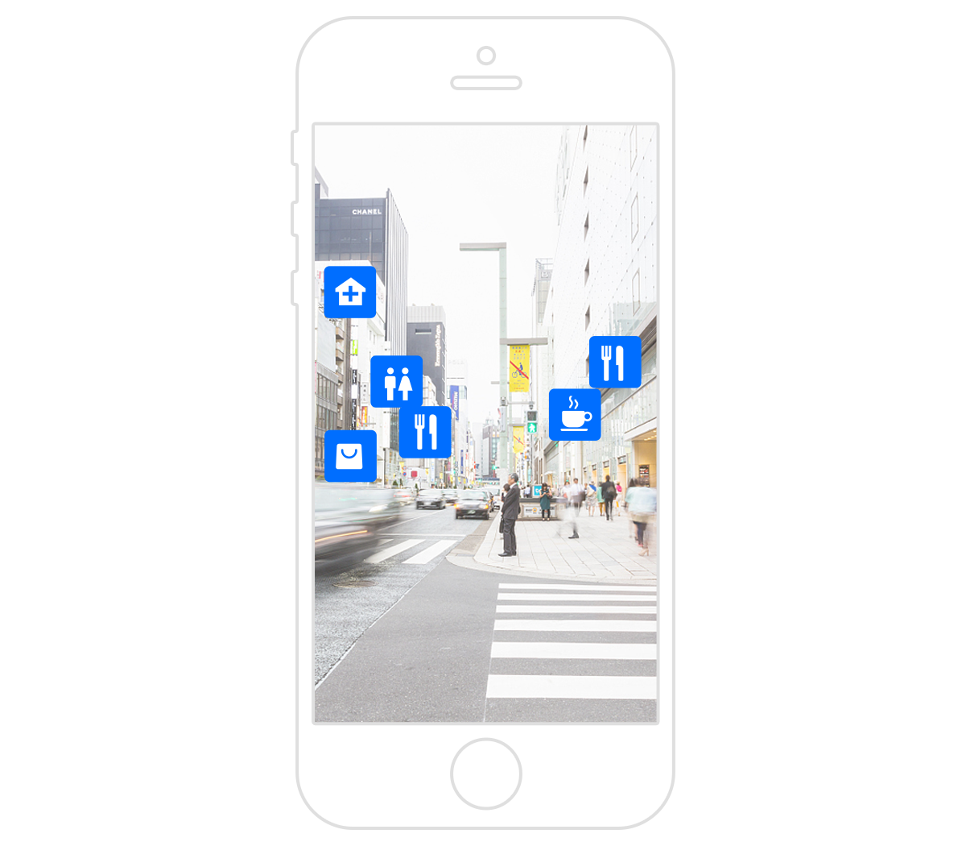
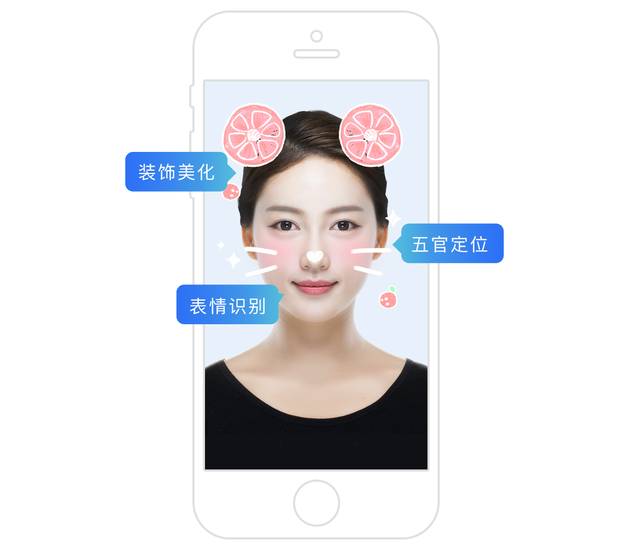
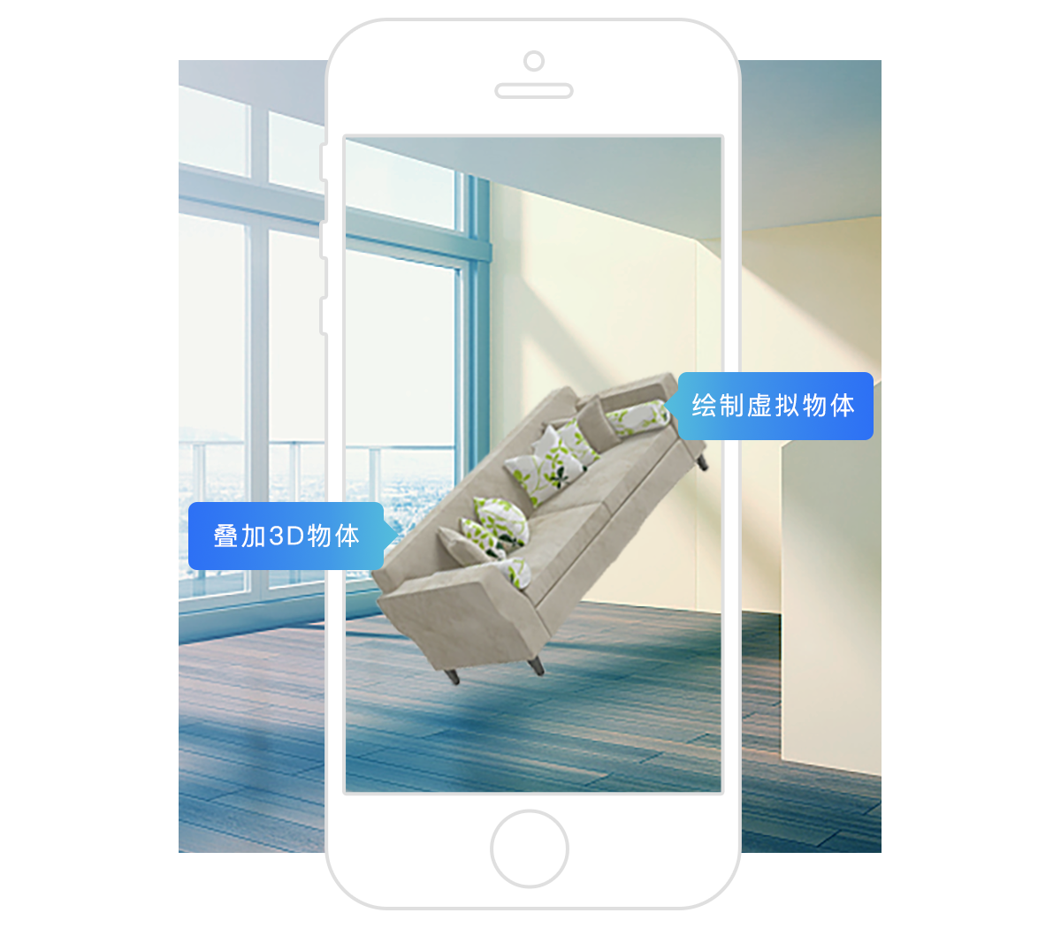
3.4 AR cloud service solution (continued)
Targeted marketing
Makeup and beauty filters
Animated effects
Notes:
Accurate marketing based on user-defined images
Scenario Description: Enterprises identify and track specific image targets and judge the target pose to achieve customized 3D advertising and marketing effect rendering for precision marketing purposes.
Function description
1. Accurate and efficient recognition and tracking of user-defined image targets, and recognition of 2D coordinates and 3D pose of target images. Multiple image targets can be recognized and tracked at the same time, up to ten targets can be tracked at the same time.
2. Effective management of cloud image targets and resources, efficient cloud image target set retrieval, providing the ability to retrieve the camera's current target in the cloud target set. Realize universal object recognition function based on deep learning, locate the object in the picture location and category information, locate and classify information down to the terminal tracking.
Face recognition based beauty beauty
Scene description: Users can perform face alignment and expression recognition, locate five senses, and superimpose beauty effects such as skin beauty and automatic makeup based on user's expression and five senses position, and also superimpose 2D beauty props such as animal ears or 3D dynamic special effects based on user's expression and facial action. Based on the recognition of the user's facial 3D texture, it can add cool effects such as 3D mask based on the facial contour and facial features.
Function Interpretation
1. Based on the user's facial contour and the position of the five senses, add automatic makeup to achieve the effect of one-click beauty.
2. Superimpose 2D or 3D beauty props and dynamic effects based on the position of the five senses, expression features and movement changes.
3. Realize detection and tracking of face area, 3D motion and 3D pose, fine positioning of face contour position and recognition of face movement and expression.
Interesting dynamic effects based on SLAM environment perception
Scene description: Based on visual perception technology, accurately perceive the geographical information of the environment, environmental plane, environmental contour, obstacles in the environment
The 3D map of the environment can be built based on a variety of environmental features such as objects. At the same time, users can superimpose 3D objects on any scene based on the environment-aware map, draw virtual objects, and add cool virtual 3D effects to the real environment.
Function Description
1. Accurately perceive environment geographic information, build 3D maps of the environment in real time, quickly obtain geographic information, and facilitate the use of users.
2. Realize environment plane detection, contour detection and object recognition in the environment for users' use.
3. Add 3D virtual objects or cool 3D motion effects based on the environment contour geographic information and object recognition results.

Slide 44
3.5 Smart venue solution
Smart venue solution
1
Smart court
2
Large-Scale conference
3
Remote meeting

Slide 45
3.5.1 Smart court
Notes:
Challenges.
As people's legal awareness increases the number of cases heard in the people's courts is increasing and the efficiency of case processing needs to be improved.
Solution features.
By applying speech recognition at the courtroom and collegium site, the live speech of each participant role, such as judge, plaintiff and defendant, can be transcribed into text transcript in real time. Customized engine for professional legal field, effectively responding to legal terminology. The system recognition accuracy rate has reached over 95%. Face verification technology, through ID card OCR recognition to obtain and display user identity information, dedicated access to identity information data sources to verify the authenticity of the user's identity information, so that the pre-trial identification work more authoritative and efficient. It provides universal OCR recognition function and supports text recognition on images of various complex scenes and any layout, which can be widely used in the recognition of printed documents, advertising diagrams and other materials.

Slide 46
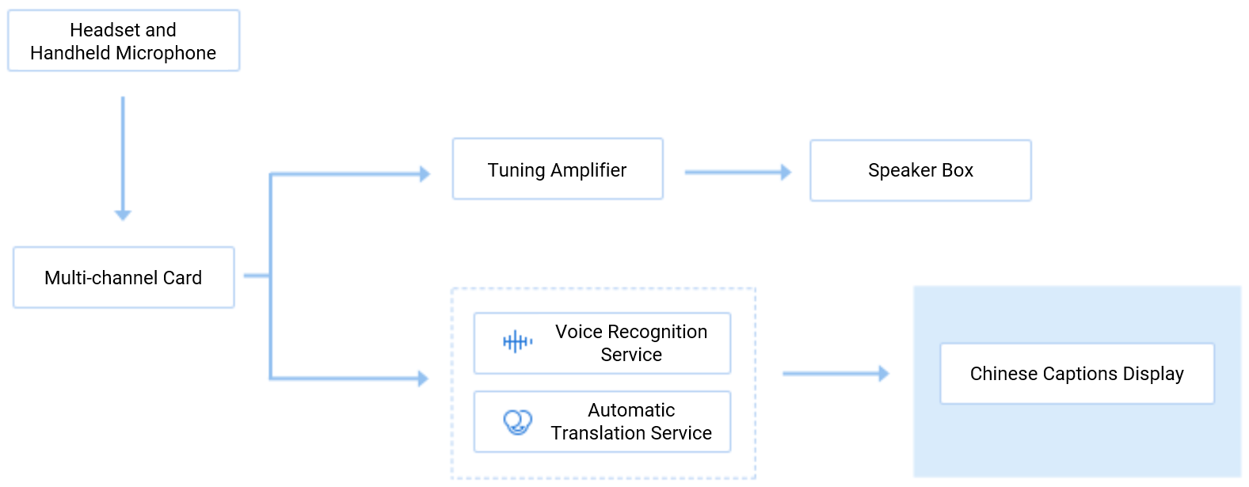
3.5.2 Large-Scale conference
Notes:
Challenges.
In traditional TV and webcast, subtitles need to be added by stenographers through typing, and quickly matched or added later in the delay of live broadcast; for English pronouncers more expensive simultaneous interpretation personnel need to be hired for English to
Chinese translation.
Program features.
By adding multi-channel sound card equipment in the meeting, both in the case of not modifying the existing system process, speech recognition of the speaker at the conference site. Customized engine for large venue environment and sound picking microphone, system recognition accuracy has reached more than 95%. Machine translation technology, on-site Chinese / English speech stream after speech recognition into text stream, can be automatically translated into Chinese / English text through automatic translation services.

Slide 47
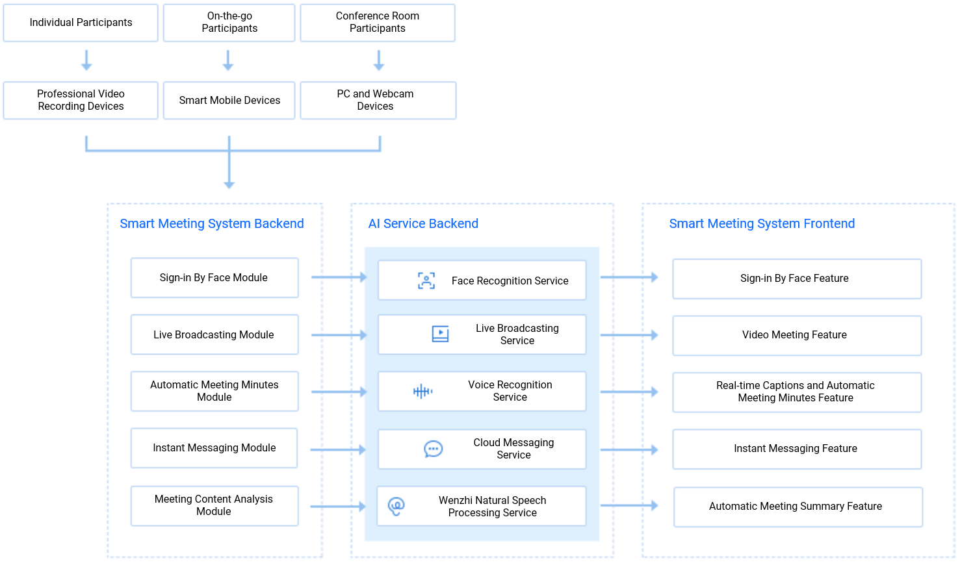
3.5.3 Remote meeting
Notes:
Challenges.
With the rapid development of technology, more and more business meetings tend to be paperless and intelligent, and the efficiency and effectiveness of meetings need to be improved.
Program features.
Through the video recording equipment of the conference system, the HD pictures of human faces are collected to realize automatic sign-in and automatic recording of meeting duration functions to improve meeting efficiency. Live broadcast and instant messaging module to achieve real-time interaction of multiple participants in different locations, including file transfer and screen sharing, etc., to increase the interaction mode and improve the effectiveness. Speech recognition service, which allows the speech content to be displayed more intuitively and ensures the participants' participation effect in noisy or silent environment. Wenzi natural language processing service, which can automatically generate meeting summaries based on meeting minutes for easy retrieval and management.

Slide 48
Reflection questions
Q1: what are the major AI technology development directions at present?
Q2: which AI technologies are used in the smart customer service?
Q3: what are the use cases of the computer vision technology?
Notes:
问题一：计算机视觉、自然语言处理、语音技术
问题二：语音识别、语音合成、自然语言处理
问题三：智能家居、语音视觉交互、AR/ VR、电商搜图购物、标签分类检索、美颜特效、智能安防、直播监管、视频平台营销、三维分析

Slide 49
Course summary
This course covers:
Concepts and evolution of AI
Industry-Specific challenges that can be solved by AI
Tencent Cloud AI service system
Tencent Cloud AI solutions

